Slide 1
SECURE APPLICATION FOR FISHERIES
J.Bhargav

Slide 2
Objective:
The aim of this project is to create a security module which will help us in blocking a particular ip addresses.

Slide 3
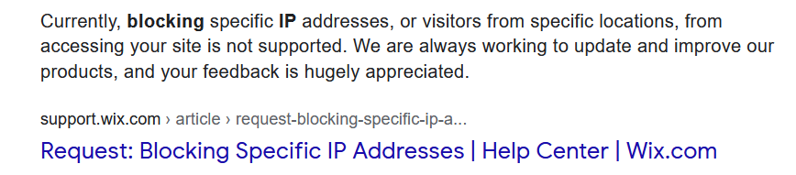
Literature survey
There are tools known as word press , wix to create websites
WordPress is having its own security features like blocking ip’s
But in wix there are no security features and not even blocking ip’s , so we are going to add it as extra feature.

Slide 4
Abstract:
The module should be in such a way that there should be a button on the website which should only be available to the developer. The module should begin when we press on that button, after pressing it, it should go to a new page there it should display User ip address of every user and beside them there should be buttons like block button and unblock button. When the user is blocked , if the user visits the webpage, he should get a message stating error 404.

Slide 5
Tools used
Html, JavaScript, database, Wix

Slide 6
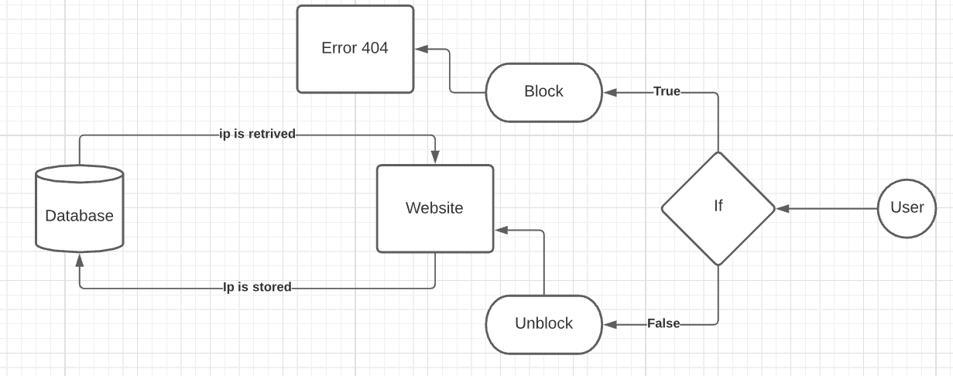
Block diagram

Slide 7
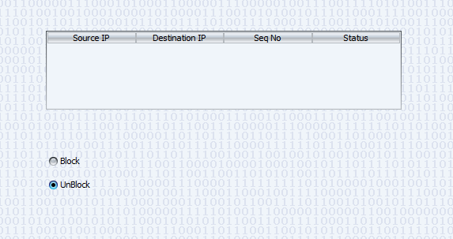
Basic security module

Slide 8
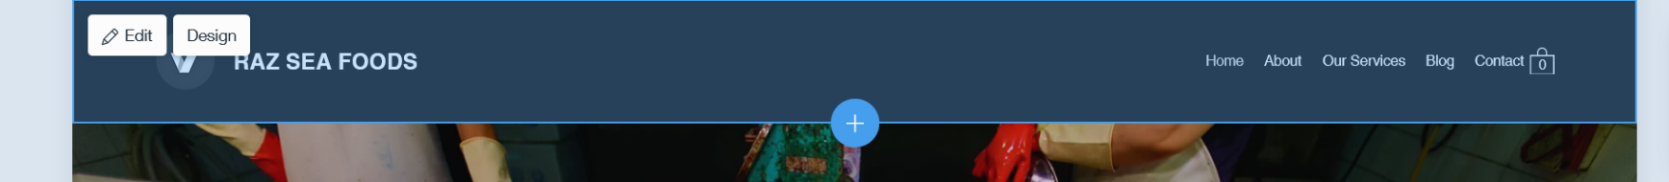
website

Slide 9
Steps to complete project
We need to create a template using java script
We need to create a database , for storing user ip’s
We need to integrate the entire module in our website

Slide 10
references
https://www.wix.com/velo/forum/community-discussion/solved-block-an-ip-and-redirect-to-another-page
https://www.geeksforgeeks.org/how-to-get-client-ip-address-using-javascript/
https://ieeexplore.ieee.org/document/5385128
https://www.wpbeginner.com/wp-tutorials/how-to-block-ip-addresses-in-wordpress/

Slide 11
Thank You

